Slide 1

Introduction to Web Scraping II

Slide 2
Selenium
Selenium is an automated web-browsing framework
While it is extensively used for software testing it is also quite useful for webscraping.
Why Selenium?
The problem with tools like BS4 is that they only retrieve the static HTML and CSS that comes from the server and not the dynamic part which is rendered using JavaScript.

Slide 3
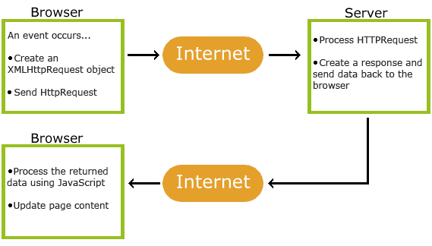
Scraper’s enemy: AJAX
AJAX stands for Asynchronous Javascript and XML. It is a developer’s dream because one can update a web page without reloading the page.

Slide 4
Example: India govt. Public data website
Consider the URL: https://data.gov.in/catalog/company-master-data
As you can see it is not possible to write a script using BS4 to scrape the webpage.

Slide 5
Solution? Selenium!
Since Selenium essential mimics a human’s behaviour on the web as it can click, wait for pages to load etc. we can avoid the pitfalls of AJAX.
Getting Started
Pip3 install -U selenium
WebDrivers for your preferred browser:
http://www.seleniumhq.org/download/
Documentation
http://selenium-python.readthedocs.io/

